Slide 1
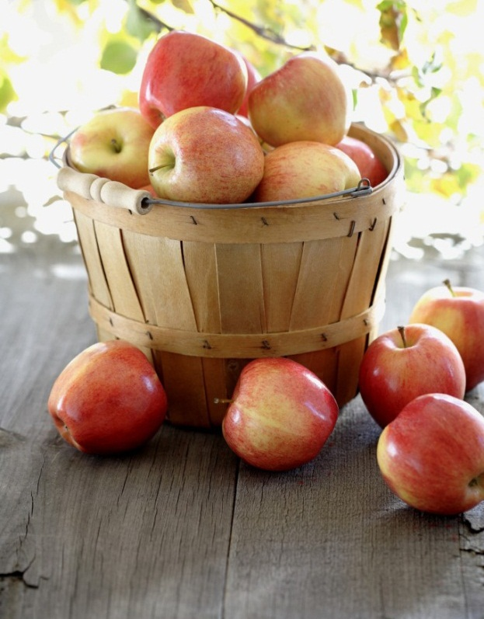

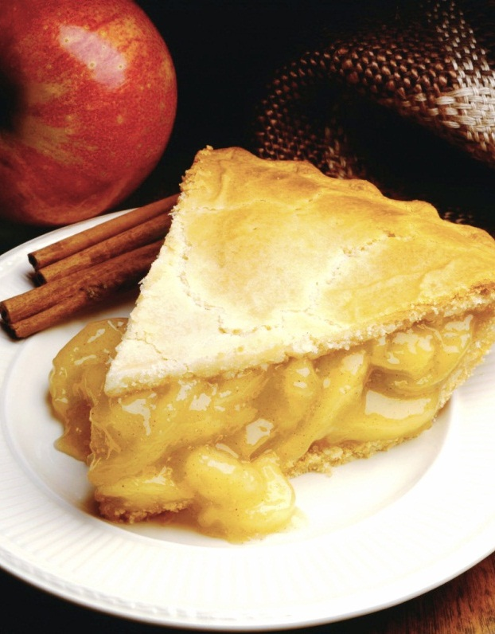
Online food delivery preferences
-By Shivam Mishra
Notes:
NOTE: To replace a picture, just select and delete it. Then use the Insert Picture icon to replace it with one of your own!

Slide 2
Project Contexte
Read the file & Basic Codes(eg. head, shape,etc.)
Visualization
Outlier
Detection
EDA
Random Forest Regressor
Decision Tree Regressor
Linear Regression
OneHotEncoding and Standard Scaler
XGBoost
Tuning
Logistic Regression
Tuning
Pickle
KNN
Tuning
Naïve Bayes
Tuning
SVM

Slide 3
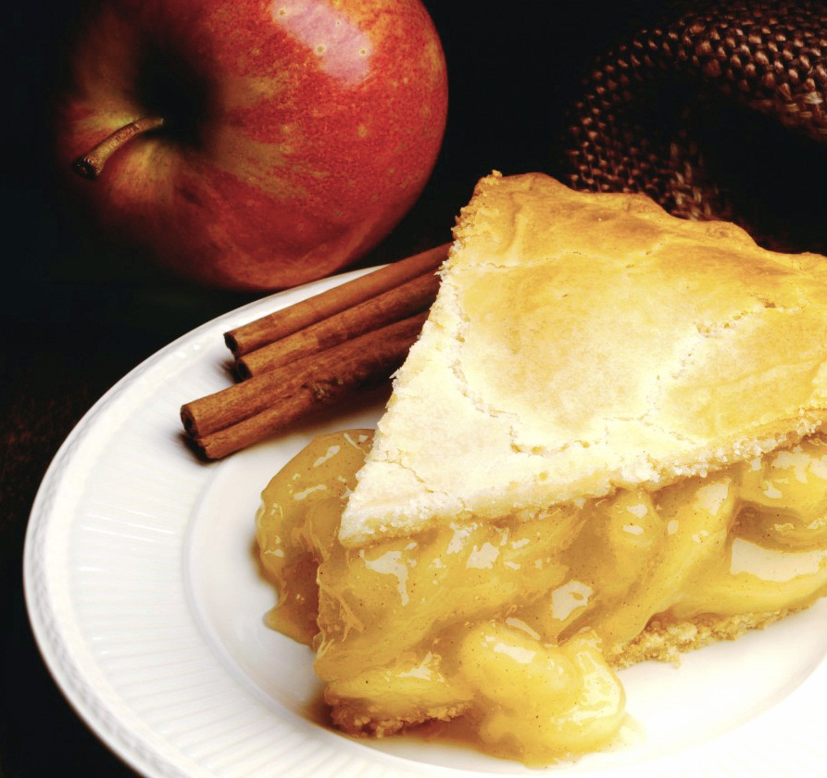
Introduction
Online food ordering is the process of ordering food, for delivery or pickup, from a website or other application. The product can be either ready-to-eat food or food that has not been specially prepared for direct.
In this project I have used the following algorithms and classifiers-
Linear Regression
Logistic Regression
SVM
KNN
In this Data set we have 388 Rows and 55 columns.

Slide 4
Scores And Errors
Before Tuning
Errors & R2
MAE
MSE
RMSE
R2 Score
Linear Regression | Decision Tree Regressor | Random Forest Regressor | XGBoost
1.5416 | 1.9072 | 8.05308 | 5.6115
3.71473 | 9.0210 | 1.3829 | 7.3831
1.9273 | 3.0035 | 1.1759 | 8.5925
1.0 | 1.0 | 1.0 | 0.99999
After Tuning
Score
R2
Linear Regression | Decision Regressor | Random Forest Regressor | XGBoost
0.9999 | 1.0 | 1.0 | 1.0

Slide 5
Result
Before Tuning
Classifiers & Regression | Precision | Recall | F1 – Score | Accuracy
Logistic Regression | 0.92 | 0.94 | 0.93 | 0.92
SVM | 0.79 | 0.91 | 0.85 | 0.79
Naïve Bayes | 0.73 | 0.70 | 0.71 | 0.63
KNN | 0.79 | 0.48 | 0.59 | 0.57
After Tuning (GridSearchCV)
Classifiers & Regression | Precision | Recall | F1 – Score | Accuracy
Logistic Regression | 0.71 | 0.85 | 0.77 | 0.71
SVM | 0.81 | 0.85 | 0.83 | 0.77
Naïve Bayes | 0.74 | 0.67 | 0.70 | 0.63
KNN | 0.78 | 0.70 | 0.74 | 0.67

Slide 6
After Tuning (RandomizedSearchCV)
Classifiers & Regression | Precision | Recall | F1 – Score | Accuracy
Logistic Regression | 0.71 | 0.88 | 0.79 | 0.73
SVM | 0.81 | 0.85 | 0.83 | 0.77
Naïve Bayes | 0.74 | 0.67 | 0.70 | 0.63
KNN | - | - | - | -
By observing the table Naïve Bayes Classifier is best fit for this Data Set. It is providing the best Accuracy.

Slide 7
Accuracy Values For Each Model
Model | Accuracy
Linear Regression | 1.000000
Logistic Regression | 0.714286
SVM | 0.785714
Naive Bayes | 0.628571
k-NN | 0.571429

Slide 8
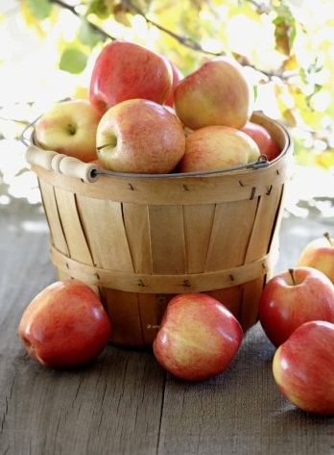
Conclusion
After using all the above Algorithms on Online food delivery preferences Bangalore region Data Set we got the different accuracies of different models.
We can say that SVM and Naïve Bayes Classifiers are giving the best accuracy before the Tuning as well as after Tuning.
This Data Set is not well performed in Linear Regression.
In the Final overall accuracy report Logistic Regression also performed well for this model.
We can say that this Data Set is best for the classifiers.

Slide 9
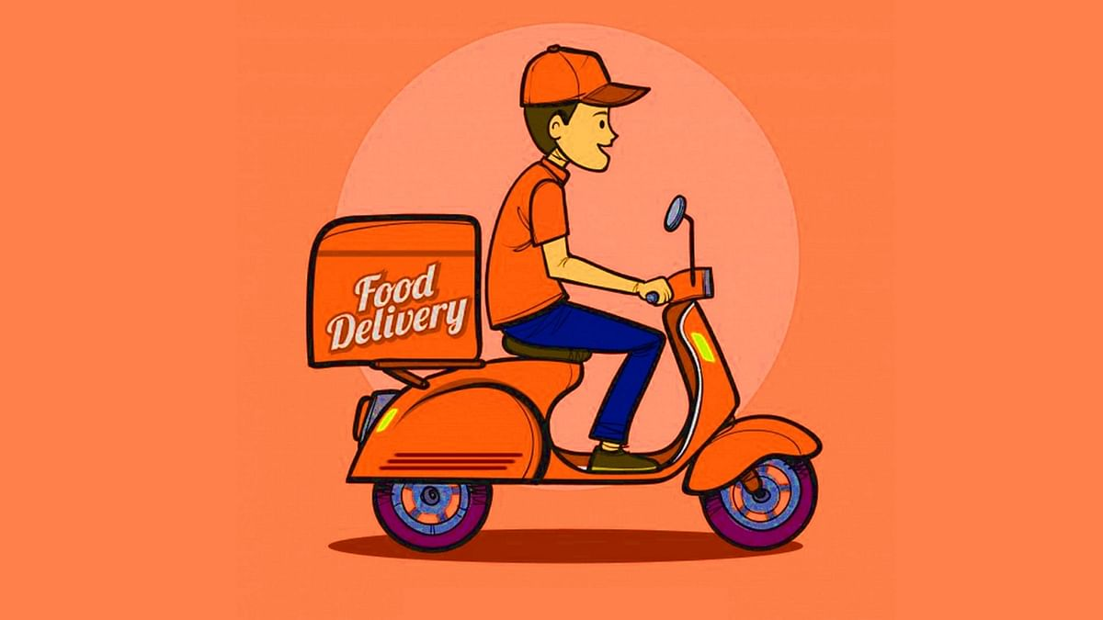
Blank slide
Thank You !

